Slide 1
Catching Social Media Advertisers with Strategy Analysis
Meng Jiang
University of Illinois at Urbana-Champaign
www.meng-jiang.com
The First International Workshop on Computational Methods for CyberSafety

Slide 2
Advertising Strategies
Before we talk about social media …
Different strategies of advertising
Bug your customer every week/month/season
Dive into your customers’ community …
Analyzing the strategies is a marketing issue
$$$
Analyzing the strategies is also a safety issue!

Slide 3
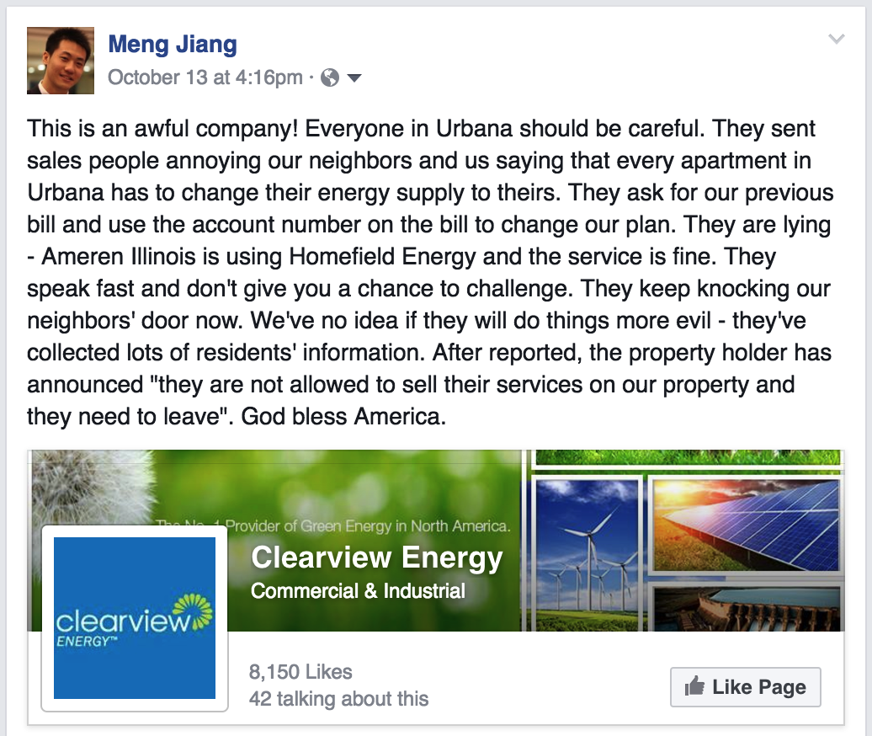
My Experience: It is a safety issue!

Slide 4

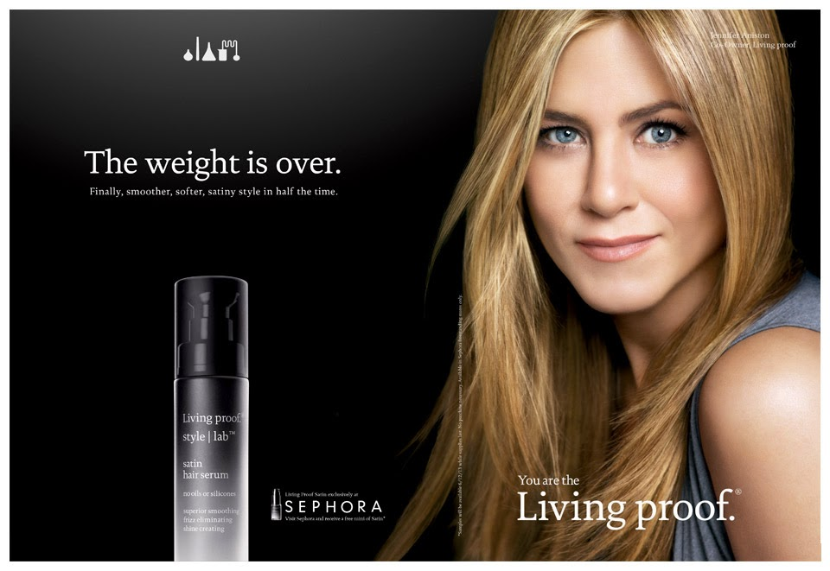
Some Strategy Examples
S1. Celebrity branding

Slide 5

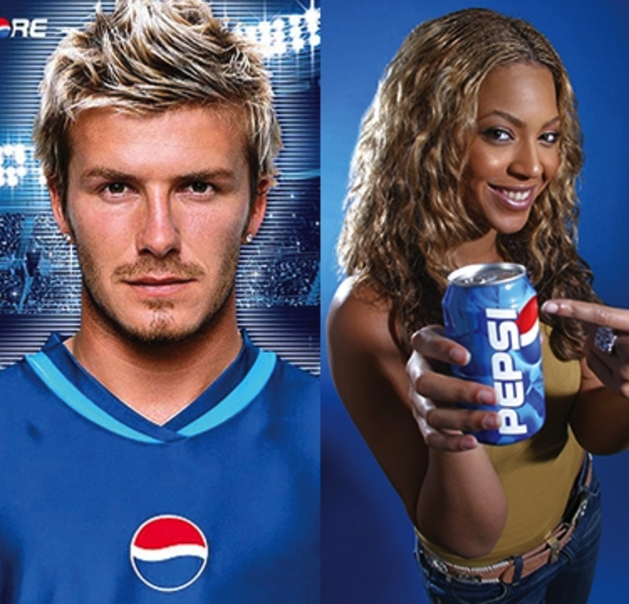
Some Strategy Examples
S2. Collaborative advertising

Slide 6


Some Strategy Examples
S3. Gift advertising

Slide 7
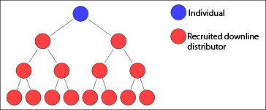

Some Strategy Examples
S4. Multi-level marketing

Slide 8
Social Media, say, Twitter-like Network?
Q: Can we spot these in social media advertising?
S1. Celebrity branding
S2. Collaborative advertising
S3. Gift advertising
S4. Multi-level marketing

Slide 9
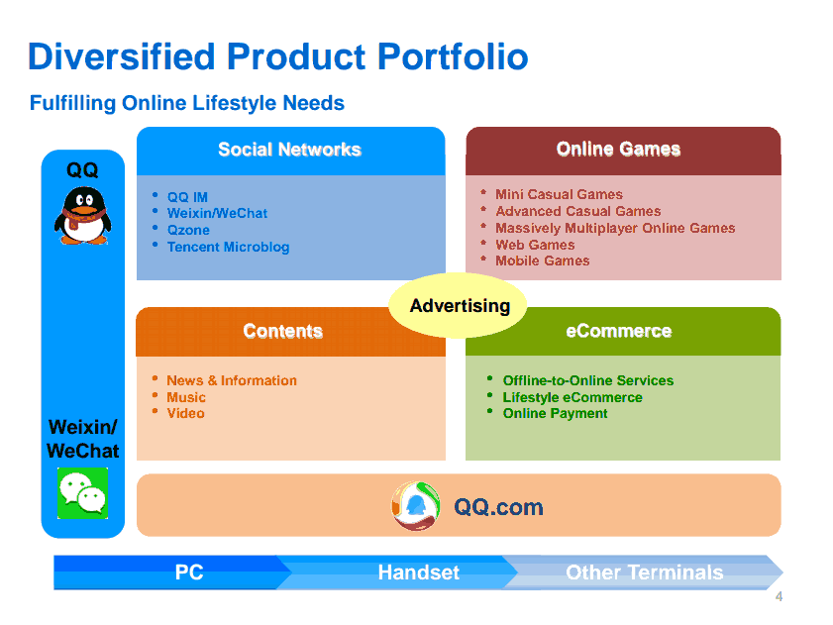

Slide 10
This Talk
Tool-wise difference: for Twitter/Weibo, marketers can set up scripts or botnets
Q1: What are the strategies? Are they new?
Q2: Can we detect the botnet advertisers that were set up by the marketers?

Slide 11
Comparing Social Media Advertising and Traditional Advertising: S1

Slide 12
Comparing Social Media Advertising and Traditional Advertising: S2

Slide 13
Comparing Social Media Advertising and Traditional Advertising: S3

Slide 14
Comparing Social Media Advertising and Traditional Advertising: S4

Slide 15
Solution 5: Synchrony Strategies in Social Media

Slide 16
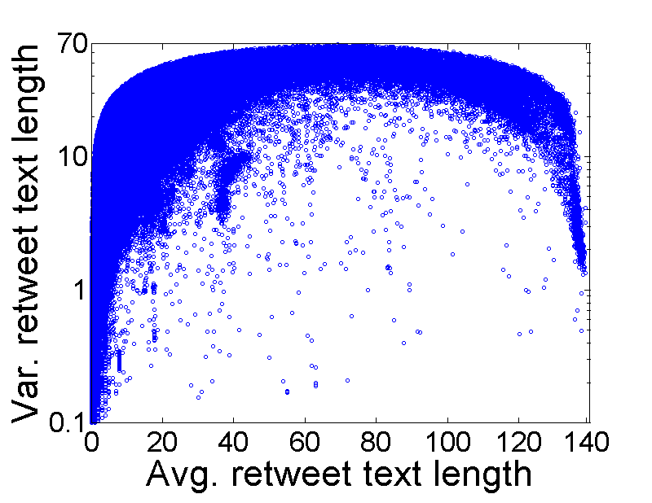
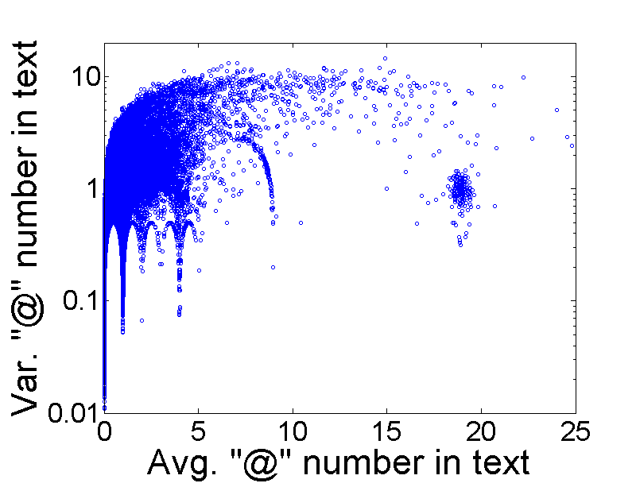
Observation: Features
Comment features and mentioning features
Every dot is a “tweet cascade”

Slide 17
Observation: Features
Lockstep behavioral features

Slide 18
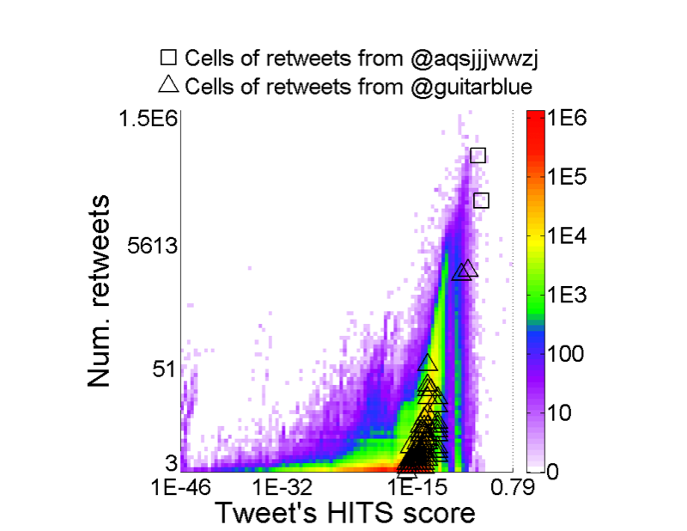
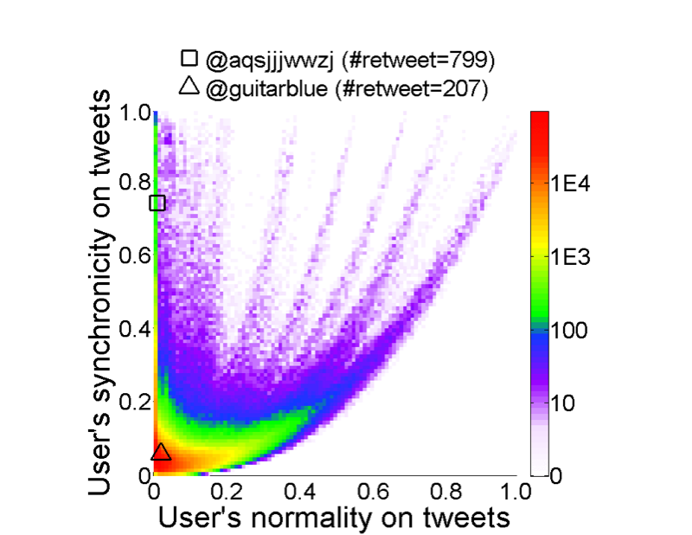
Observation: Features
Message synchrony [CatchSync, KDD’14]

Slide 19
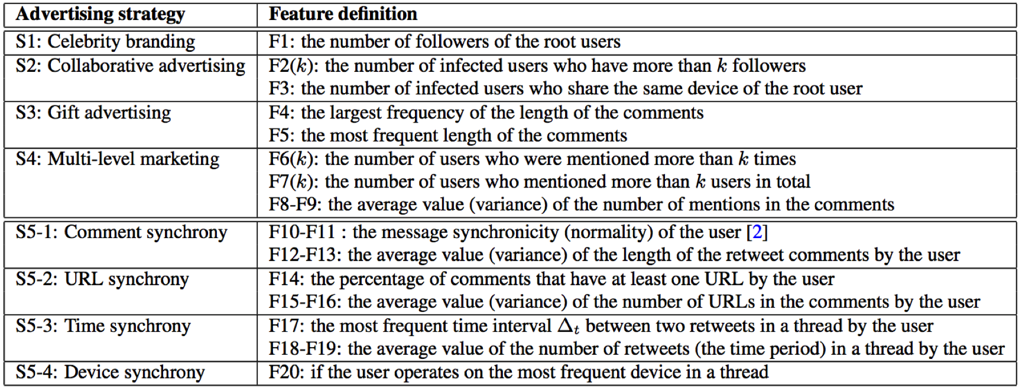
Modeling: Features

Slide 20
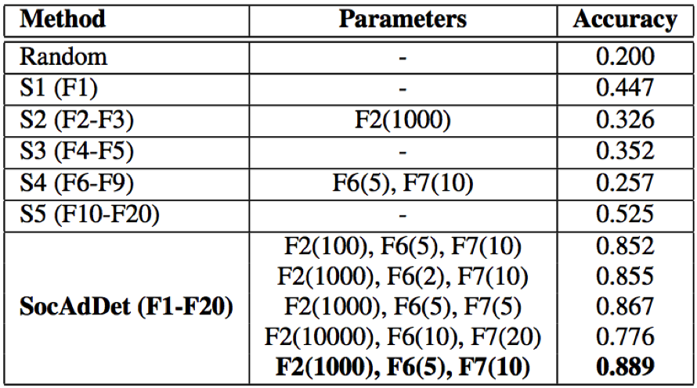
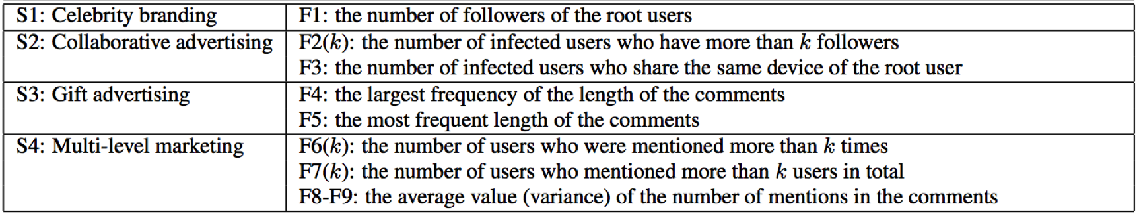
Experimental Results
T1: Which strategy the tweet used? 5-class classification.

Slide 21
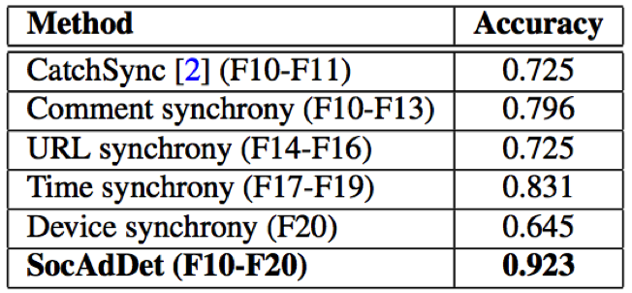
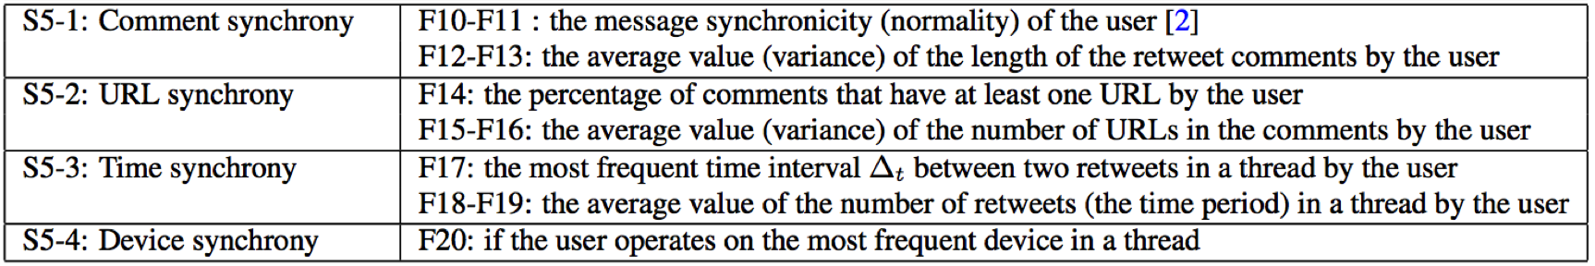
Experimental Results
T2: Detecting botnet advertisers (spammers in synchrony): binary classification.

Slide 22
Summary
Comparing social media advertising strategies and traditional strategies
Celebrity branding
Collaborative advertising
Gift advertising
Multi-level marketing
Synchrony (social media botnet)
Strategy classification: 0.889
Spammer detection: 0.923
Faster but not smarter!
Future work: Can we early predict?!

Slide 23
Thank you!
Catching Social Media Advertisers with Strategy Analysis

